Slide 1
Science and Drawing

Slide 2
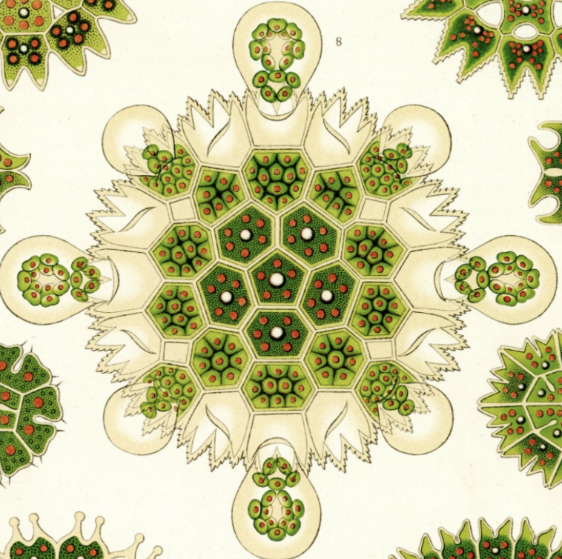
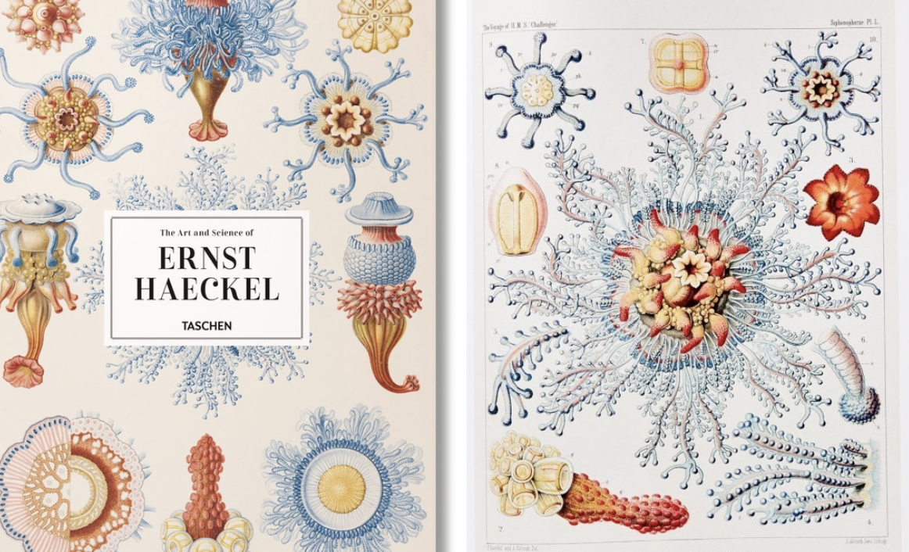
Scientific Illustration
Before photography, scientific illustration was an important part of scientific communication. It is still valued now for the detailed and accurate drawings that represent a plant/animal/organism in ways a photograph cannot. There are college programs you can attend to become a science illustrator. Below are two drawings of a well-known scientific illustrator, Ernst Haeckel, whose work has also been recognized as artwork. The drawing on the left is of algae.

Slide 3
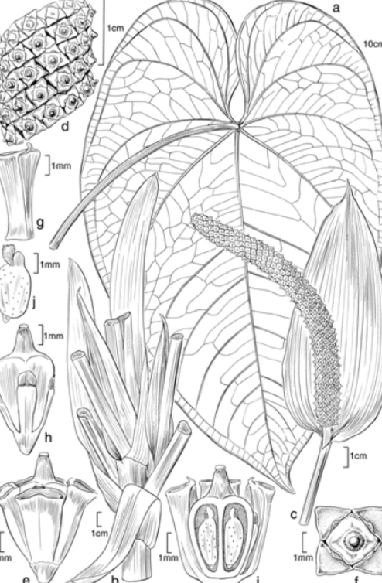
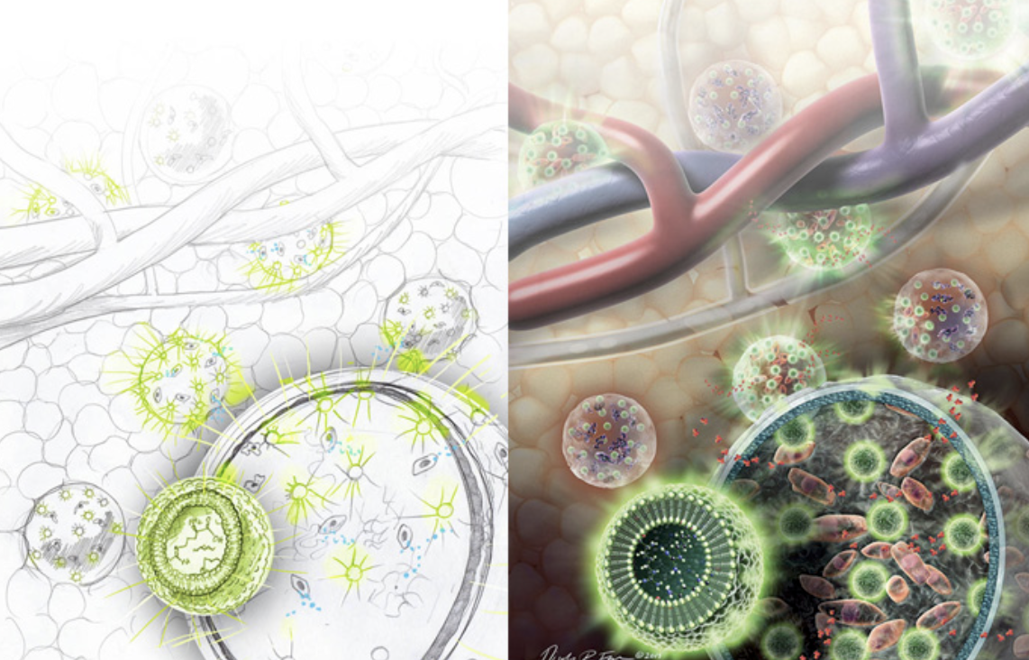
Other examples of Scientific Illustration

Slide 4
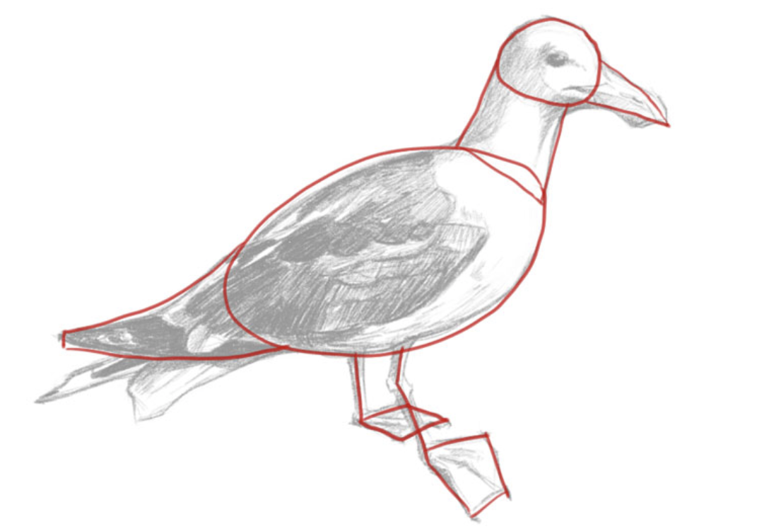
How do I draw that?!
Draw lightly so it’s easy to erase pencil lines
Tools:
Sharpened Pencil, Watercolor Color Pencils, Watercolor Paper, Brushes
Sketch lightly so you don’t have to or it is easy to erase
Make things proportionate to each other
Pay attention to the aesthetic (design and composition to make things visually pleasing)
Start with simple shapes
LOOK closely at the algae photo and/or
natural object what is its overall shape?
What small shapes are inside.
Draw the largest shape first, break down
into smaller shapes and and finally create it as
a whole. See example!

